Slide 1
Student Course Registration System
Programming Fundamentals – Assignment 2
C++
MOHAMAD IBRAHIM BIN MOHD AKIF A26WD0354 (Leader)
FANG SZE WEI A26DW0281
NURHADHINA BINTI MD.HAFEZ A26DW2271
LIM ZHONG JUN A26DW2518
NURUL NAZLYANA BINTI KAMARUZAMAN A26DW0280
Notes:
Introduce yourself, the course and the topic of the assignment.

Slide 2
Problem Description & Objective
The program reads a student’s details and the credit hours of each subject, calculates the total tuition fee, and checks whether the total credit hours exceed the maximum permitted.
1
2
3
Total credit hours
Compare with limit
Tuition fee + status
Add up the credit hours of every subject
Is total ≤ maximum permitted?
Fee shown only if registration is successful
Notes:
This program helps a student register subjects and checks the credit load.

Slide 3
Input / Process / Output
INPUT
PROCESS
OUTPUT
Student ID
Student name
Number of subjects
Credit hours of each subject
Fee per credit hour
Maximum permitted credit hours
Add up credit hours of all subjects
Compare: totalCreditHours <= maxCreditHours
If valid: total fee = total credit hours × fee per credit hour
Successful: ID, name, subjects, total credit hours, total tuition fee, status
Unsuccessful: same details, no fee, status "Unsuccessful"
Notes:
Walk through the three columns left to right.

Slide 4
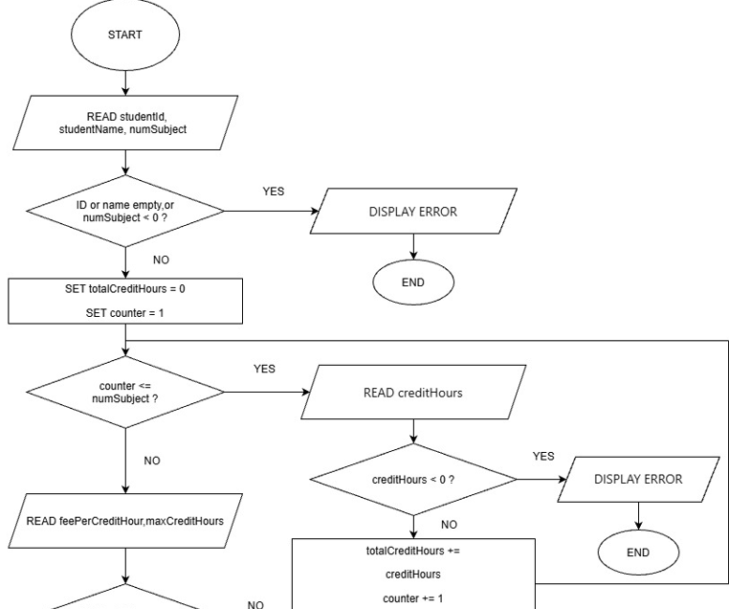
Flowchart (1/2): Input and Credit Loop
Start → read ID, name, number of subjects
Set totalCredits = 0, counter = 1
Loop while counter <= numSubjects
Each pass: read credit hours, add to total, counter + 1
When the loop ends: read fee rate and max credit
Notes:
The loop repeats once per subject: read credit hours, add to total, increase counter.

Slide 5
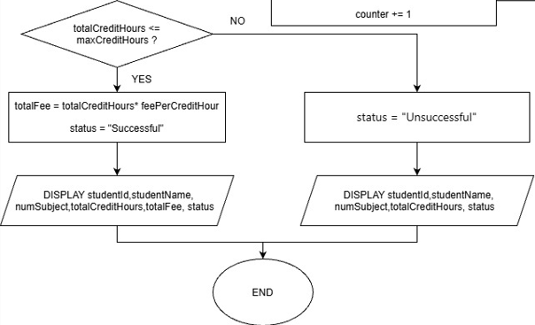
Flowchart (2/2): Decision and Two Branches
Yes (total ≤ max)
Calculate fee, status = Successful, display everything
No (total > max)
Status = Unsuccessful, no fee displayed
Notes:
Decision: total credits <= max credit. Yes -> fee + Successful. No -> Unsuccessful, no fee.

Slide 6
Program Structure: 9 Functions + main
processRegistration
inputStudentId
inputStudentName
Controls the whole flow
Read and check ID
Read and check name
inputNumberOfSubjects
inputCreditHours
inputFeePerCreditHour
Read number of subjects
Read credit hours of one subject
Read fee per credit hour
inputMaxCreditHours
calculateTotalFee
displayError
Read maximum credit hours
Total credits × fee rate
Show an error message
main() { return processRegistration(); }
Notes:
main() only calls processRegistration(). Each function does one job.

Slide 7
Code: processRegistration() – Overall Flow
string studentId = inputStudentId("");
if (studentId.empty()) { return 0; }
string studentName = inputStudentName("");
if (studentName.empty()) { return 0; }
int numSubject = inputNumberOfSubjects(0);
if (numSubject < 0) { return 0; }
// loop, fee rate, max credit ... (next slide)
if (totalCreditHours <= maxCreditHours) {
// Successful
} else {
// Unsuccessful
}
Step by step
Read ID, name and number of subjects
Invalid input: show error and stop
Selection (if / else) decides Successful or Unsuccessful
Notes:
Each input function returns an empty string or -1 on invalid input, and the process stops.

Slide 8
Code: Credit Hours Loop
int totalCreditHours = 0;
int creditHours;
for (int i = 0; i < numSubject; ++i) {
creditHours = inputCreditHours(i + 1);
if (creditHours < 0) { return 0; }
totalCreditHours += creditHours;
}
totalCreditHours = 0
i < numSubject
inputCreditHours(i + 1)
totalCreditHours += creditHours
Flowchart: SET TOTAL_CREDITS = 0
Flowchart: COUNTER <= NUM_SUBJECTS ?
Flowchart: READ CREDIT_HOURS
Flowchart: TOTAL_CREDITS + CREDIT_HOURS
The loop runs once for each subject, so the program works for any number of subjects.
Notes:
The for loop is the same idea as the WHILE loop in the flowchart: repeat numSubject times.

Slide 9
Code: calculateTotalFee and Output Branches
double calculateTotalFee(int totalCreditHours,
double feePerCreditHour) {
return totalCreditHours * feePerCreditHour;
}
Successful branch
Student name, ID, number of subjects, total credit hours, total tuition fee, status
if (totalCreditHours <= maxCreditHours) {
totalFee = calculateTotalFee(
totalCreditHours, feePerCreditHour);
// show details + fee
// Status: Successful
} else {
// show details (no fee)
// Status: Unsuccessful
}
Unsuccessful branch
Same details but no tuition fee, status shows Unsuccessful
Notes:
The fee is calculated and displayed only when the registration is successful.

Slide 10
Test Case 1: Normal Registration
Actual output
PASS
Input
ID & name: S101, Alex
Subjects: 3
Credit hours: 3, 3, 4
Fee per credit hour: RM 100
Maximum credit hours: 12
Expected result
Total credit hours: 10
Total tuition fee: RM 1000
Status: Successful
=================================
Student Name: Alex
Student ID: S101
Number of Subjects: 3
Total Credit Hours: 10
Total tuition fee: RM 1000
Registration Status: Successful
=================================
Total 10 is below the limit of 12, so the fee is calculated.
Notes:
Total 10 is below the limit of 12, so the fee is calculated.

Slide 11
Test Case 2: Boundary (Exactly at Limit)
Actual output
PASS
Input
ID & name: S102, Bella
Subjects: 4
Credit hours: 3, 3, 3, 3
Fee per credit hour: RM 150
Maximum credit hours: 12
Expected result
Total credit hours: 12
Total tuition fee: RM 1800
Status: Successful
=================================
Student Name: Bella
Student ID: S102
Number of Subjects: 4
Total Credit Hours: 12
Total tuition fee: RM 1800
Registration Status: Successful
=================================
Total 12 = maximum 12 and still succeeds. This proves the program uses <= and not <.
Notes:
Total 12 = maximum 12 and still succeeds. This proves the program uses <= and not <.

Slide 12
Test Case 3: Exceeded Limit
Actual output
PASS
Input
ID & name: S103, Charlie
Subjects: 4
Credit hours: 4, 4, 3, 3
Fee per credit hour: RM 100
Maximum credit hours: 12
Expected result
Total credit hours: 14
Status: Unsuccessful
Tuition fee: not displayed
=================================
Student Name: Charlie
Student ID: S103
Number of Subjects: 4
Total Credit Hours: 14
Registration Status: Unsuccessful
=================================
Total 14 is above 12, so registration fails and no fee is shown.
Notes:
Total 14 is above 12, so registration fails and no fee is shown.

Slide 13
Summary
The program reads student details, totals the credit hours, checks the credit limit and shows the tuition fee only for a valid registration.
Functions
Loop
Split the program into small parts, each with one job
for loop adds up credit hours for every subject
Selection
Testing
if / else decides Successful or Unsuccessful
Normal, boundary and failure cases all passed
What we learned: planning with a flowchart first makes the code easier to write and to test.
Notes:
The program meets all requirements and passed all three test cases.

Slide 14
Thank You
Any questions?

